Slide 1
PRESENTASI WEEK 1 BOOTCAMP DUMBWAYS
Asep Saepul Rohman

Slide 2
AWS
Create & Setup Server
Server for Application
Reverse Proxy
Custom Domain
SSL Configuration

Slide 3
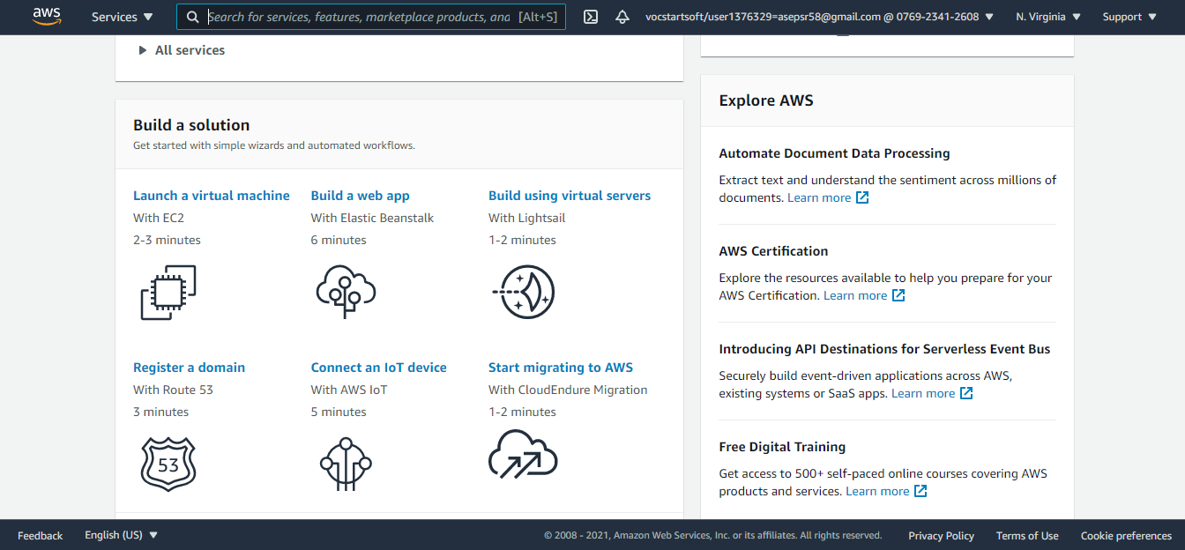
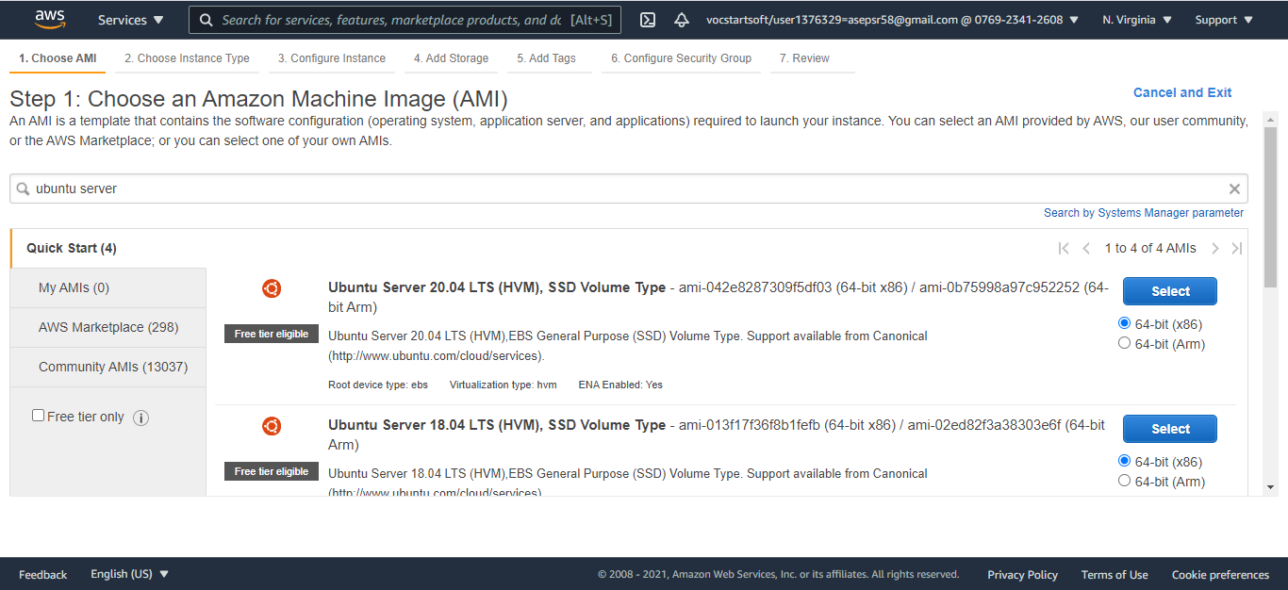
Setup Server AWS

Slide 4
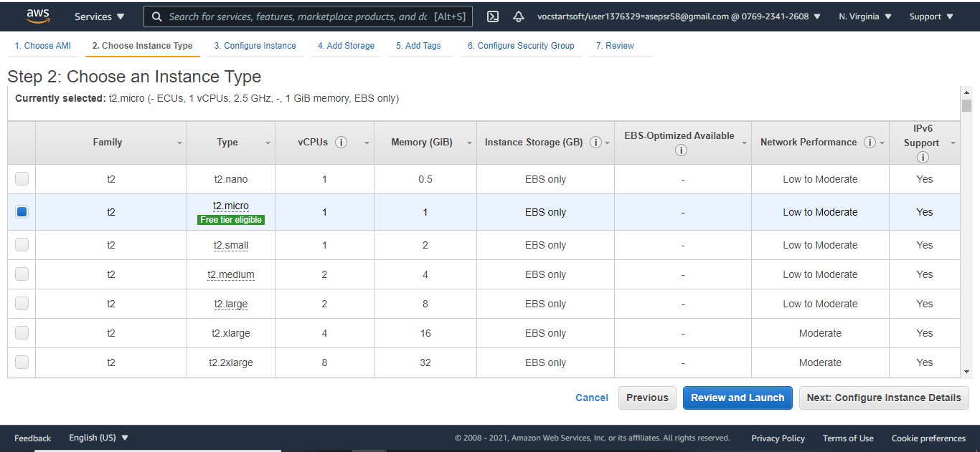
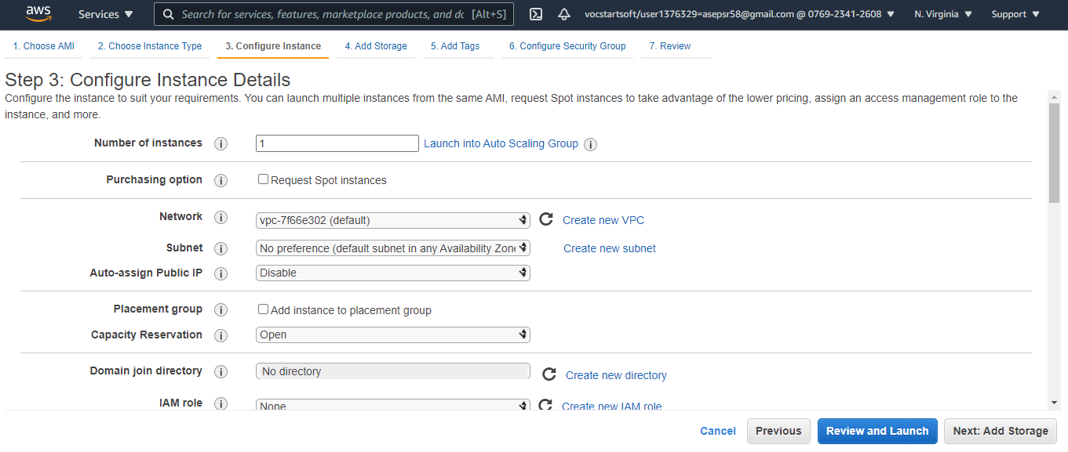
Setup Server AWS

Slide 5
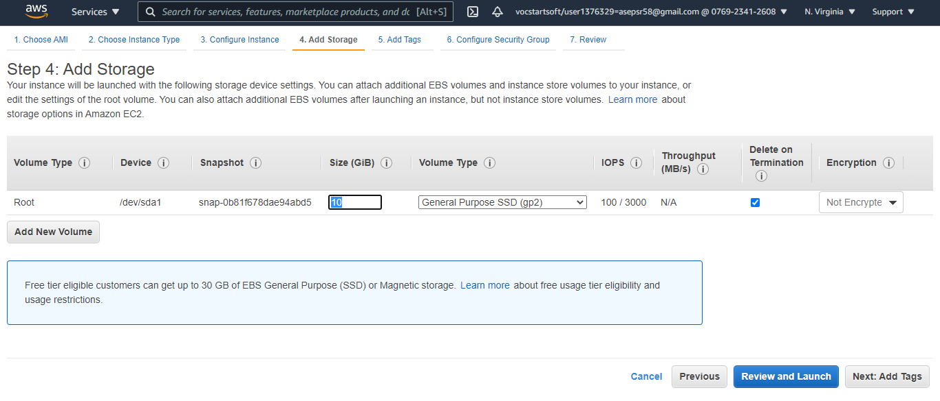
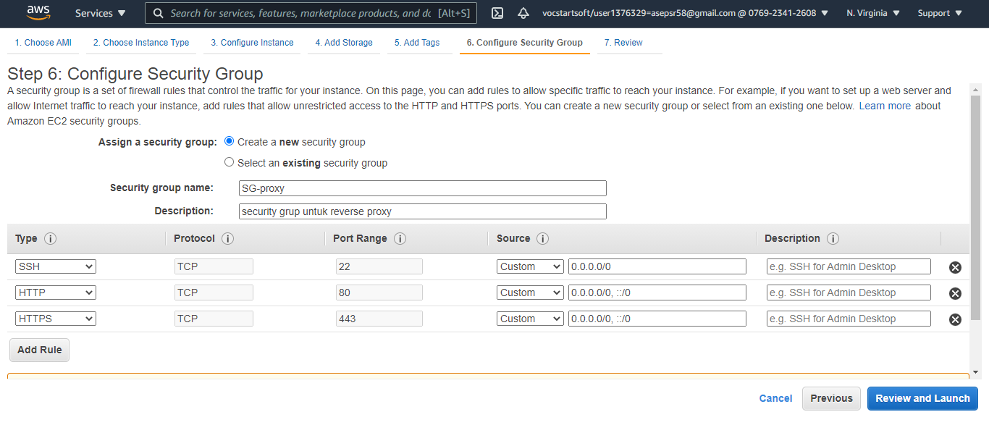
Setup Server AWS

Slide 6
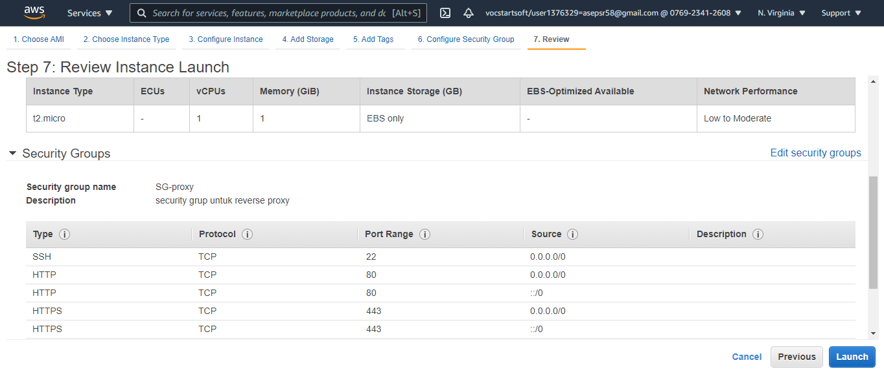
Setup Server AWS

Slide 7
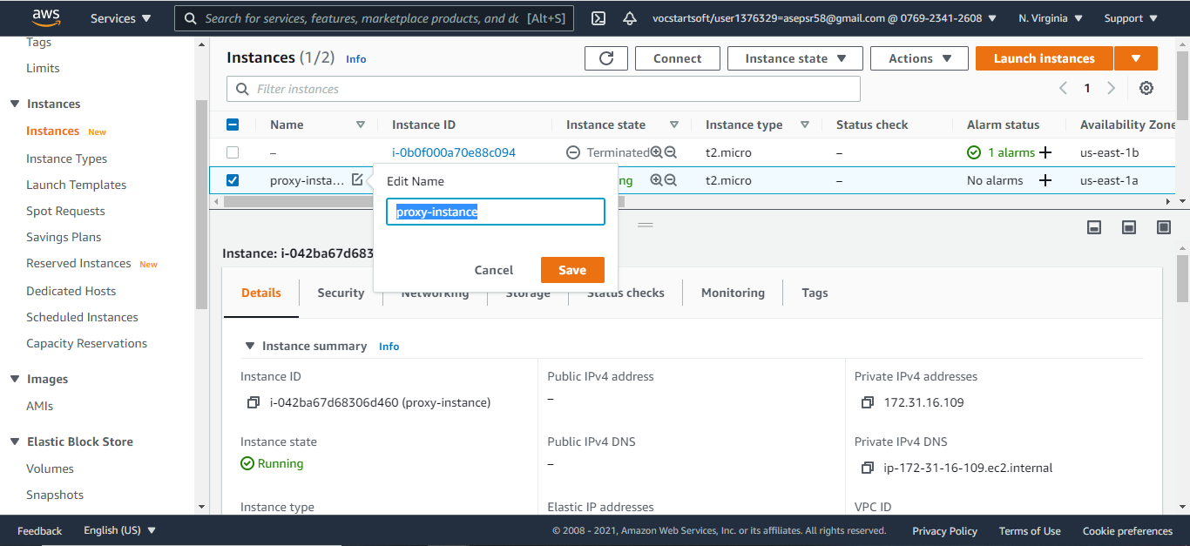
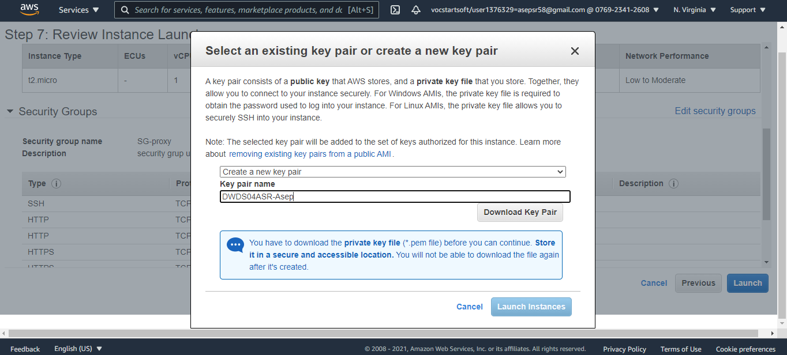
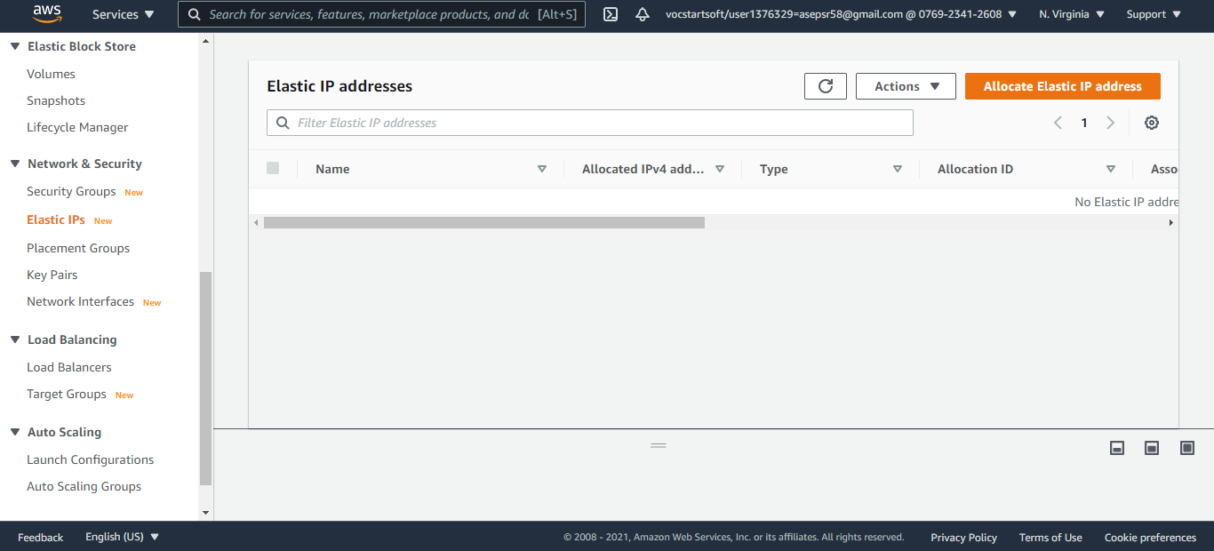
Setup Server AWS

Slide 8
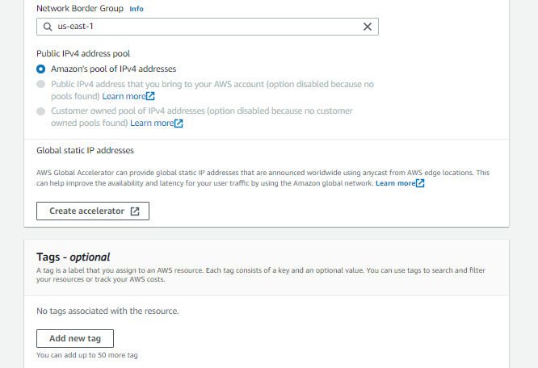
Setup Server AWS

Slide 9
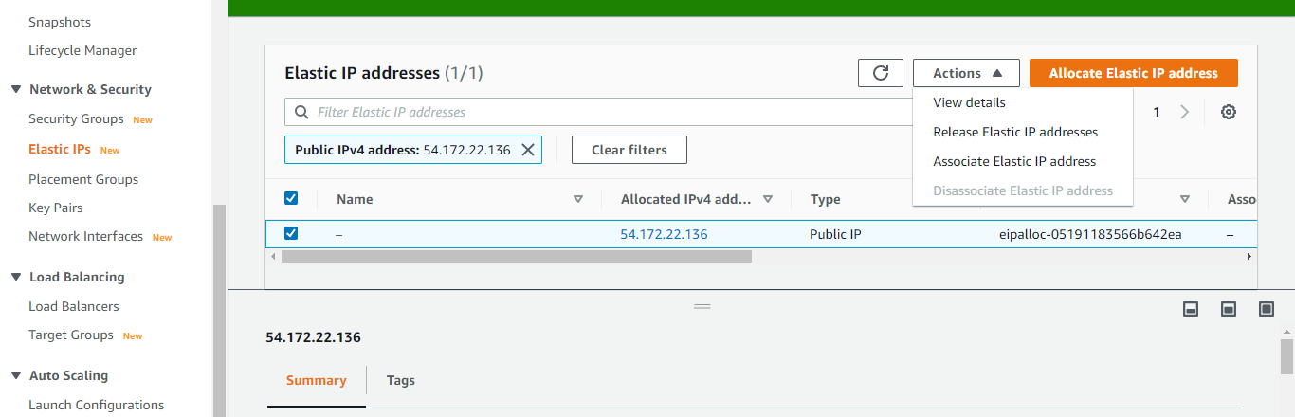
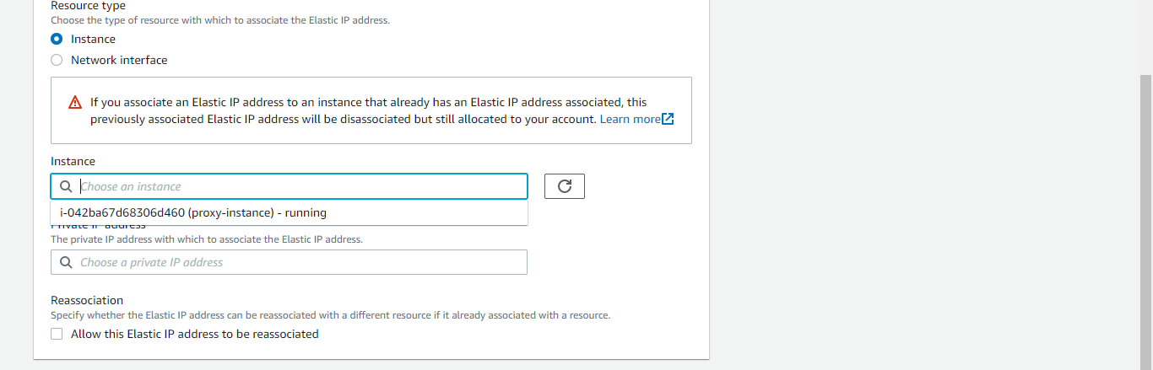
Setup Server AWS

Slide 10
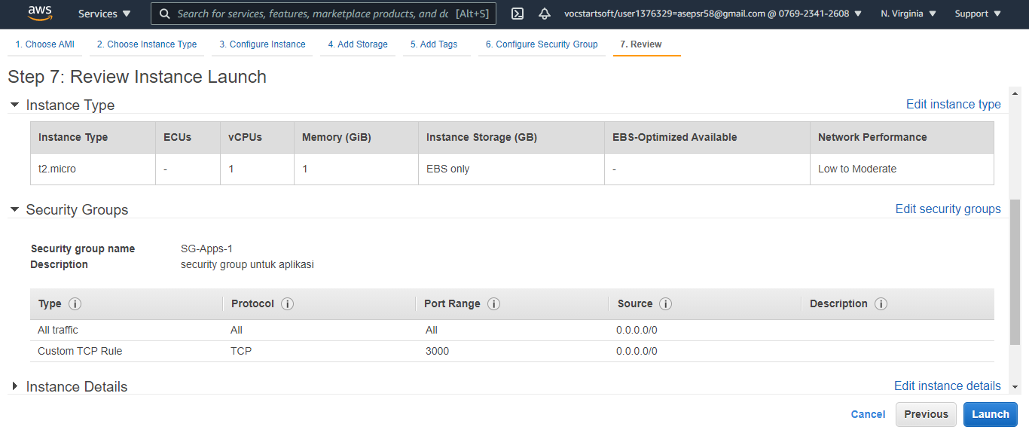
Setup Server AWS

Slide 11
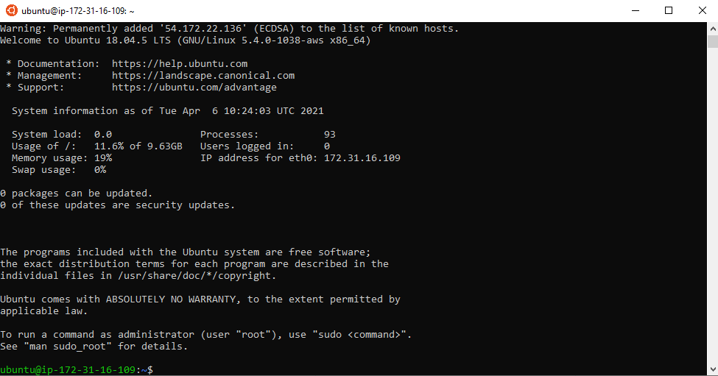
Setup Server AWS
Chmod 400 SSH Key
Login ssh - i DWDS04ASR-asep.pem ubuntu@54.172.22.136
Buat user baru dengan “adduser”
sudo scp DWDS04ASR-asep.pem ubuntu@54.172.22.136

Slide 12
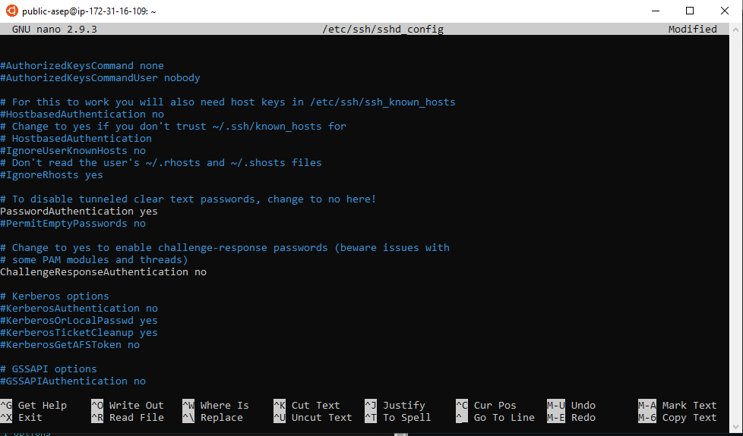
Setup Server AWS
Sudo nano /etc/ssh /sshd_config
Restart ssh “sudo systemctl restart sshd.service”
Login tanpa ssh-key “ssh public-asep@54.172.22.136”

Slide 13
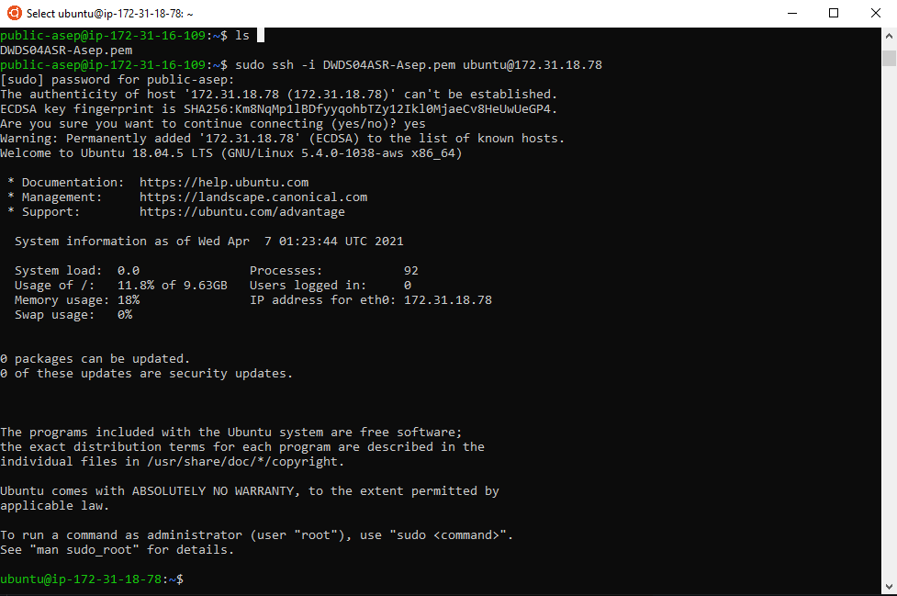
Setup Server AWS
Test remote ssh yang sudah di scp tadi dari instance proxy ke instance apps

Slide 14
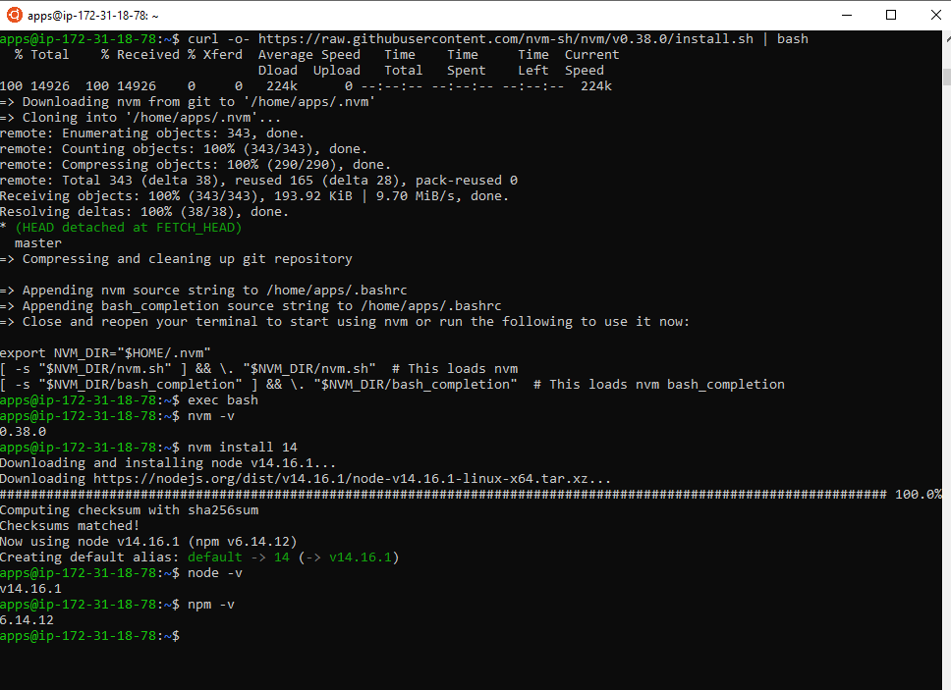
Server for Application
- Curl -o- https://raw.githubusercontent.com/nvm-sh/nvm/0.38.0/install.sh | bash
nvm install 14
Git clone https://github.com/sgnd/wayshub-frontend
Npm install

Slide 15
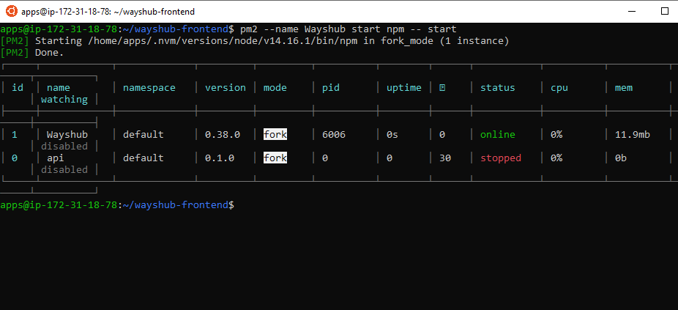
Server for Application
Npm install pm2 -g
Pm2 --name wayshub start npm -- start

Slide 16
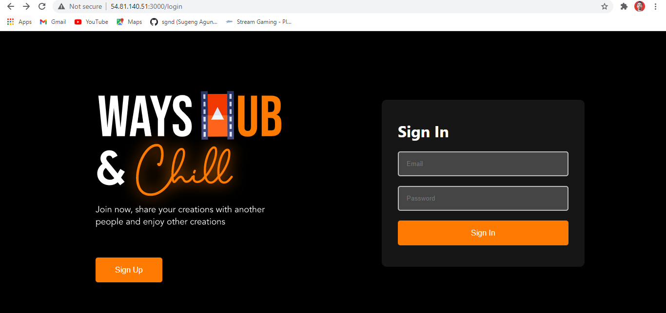
Server for Application

Slide 17
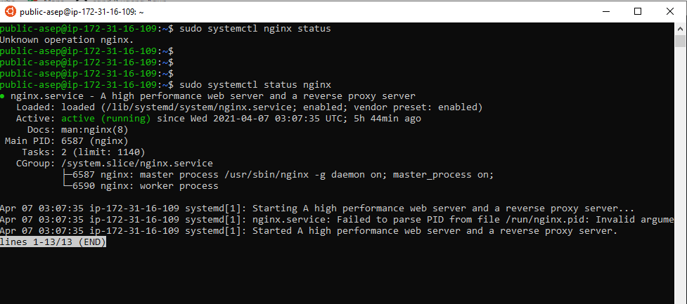
Reverse Proxy
sudo apt update && sudo apt upgrade
sudo apt install nginx
sudo systemctl start nginx
sudo systemctl status nginx

Slide 18
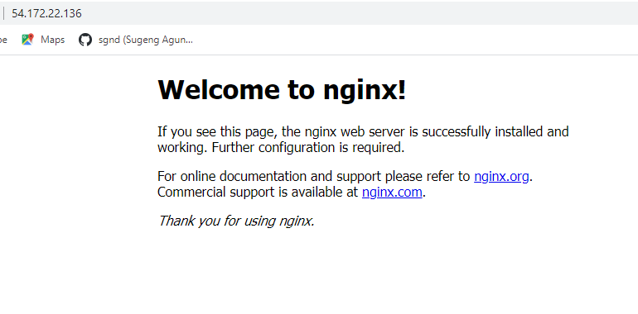
Reverse Proxy

Slide 19
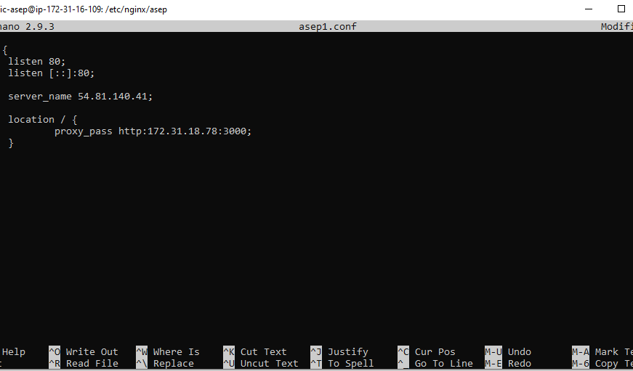
Reverse Proxy
Membuat file directory baru “asep” di /etc/nginx
Cd /etc/nginx/asep
Sudo nano asep1.conf

Slide 20
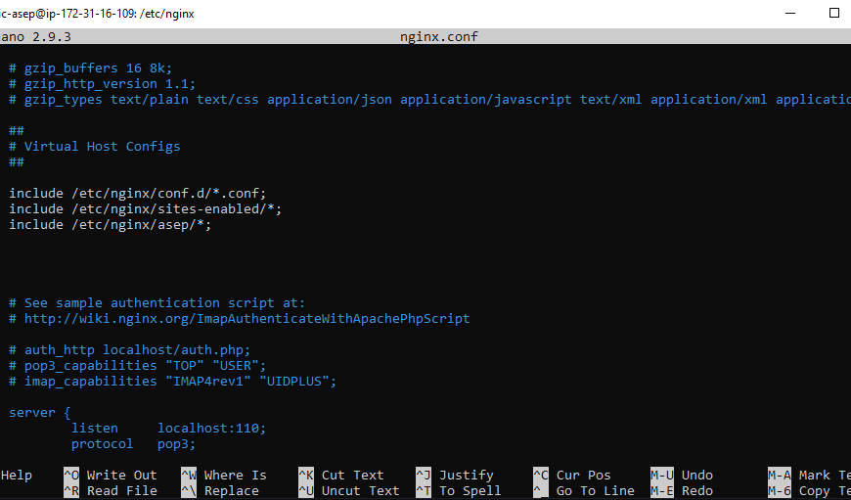
Reverse Proxy
Menambahkan konfigurasi di file nginx.conf
Cd /etc/nginx/
Sudo nano nginx.conf

Slide 21
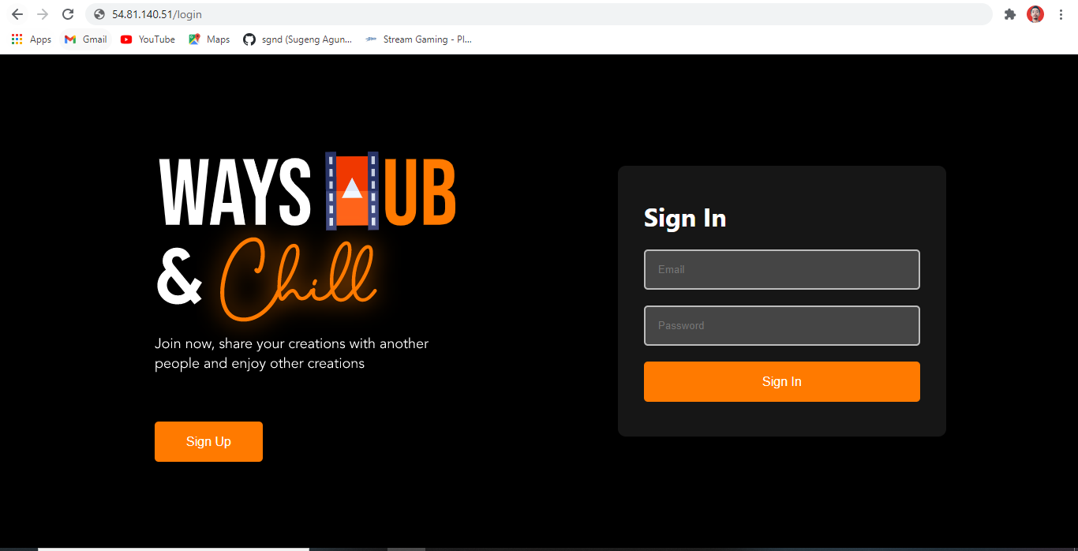
Reverse Proxy

Slide 22
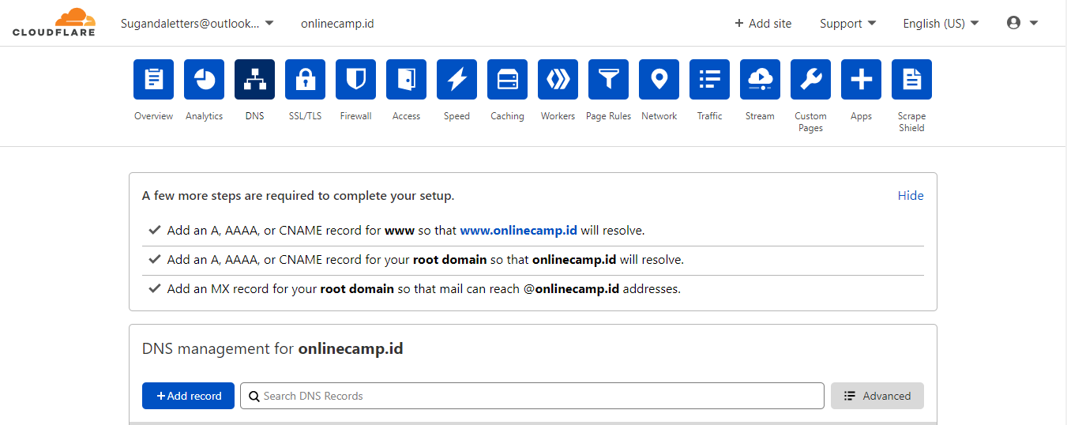
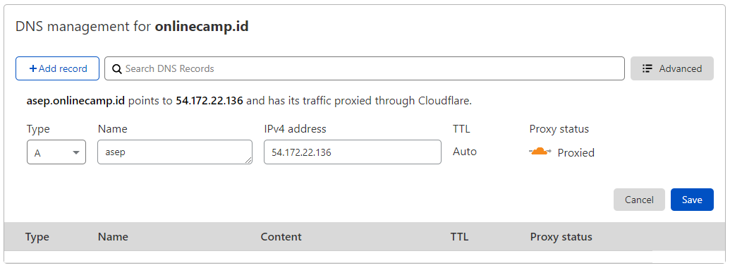
Custom Domain

Slide 23
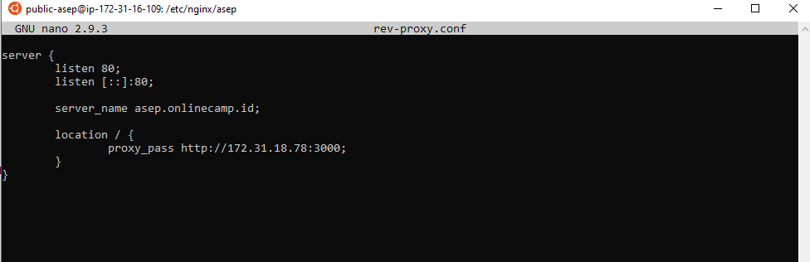
Custom Domain

Slide 24
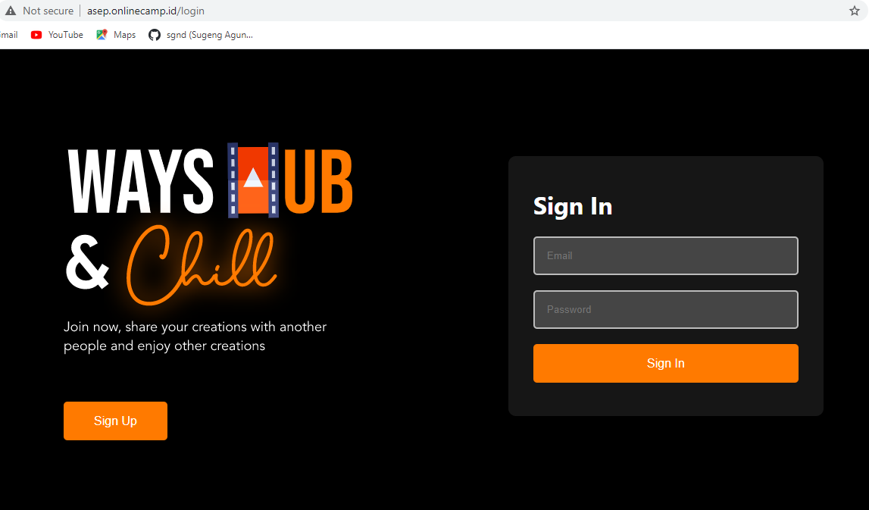
Custom Domain
Setelah SSL dikonfigurasi

Slide 25
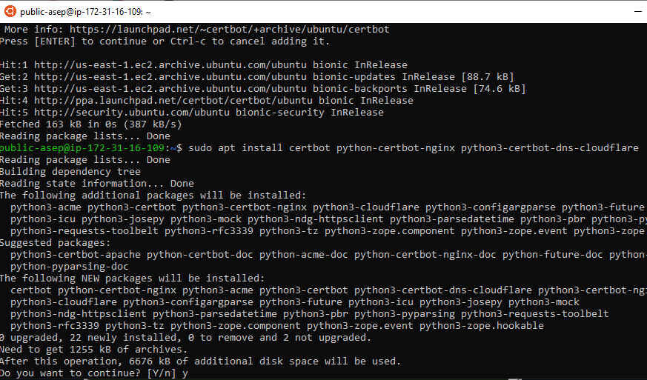
Konfigurasi SSL
Sudo apt install software-common-properties
Sudo add-apt-repository ppa:certbot/certbot
sudo apt install certbot python-certbot-nginx python3-certbot-dns-cloudflare

Slide 26
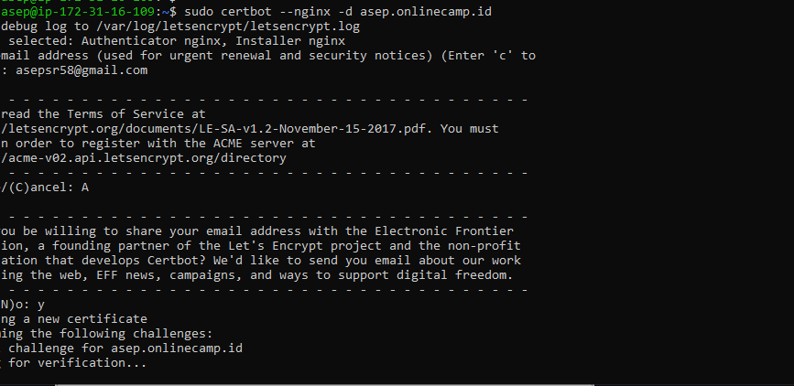
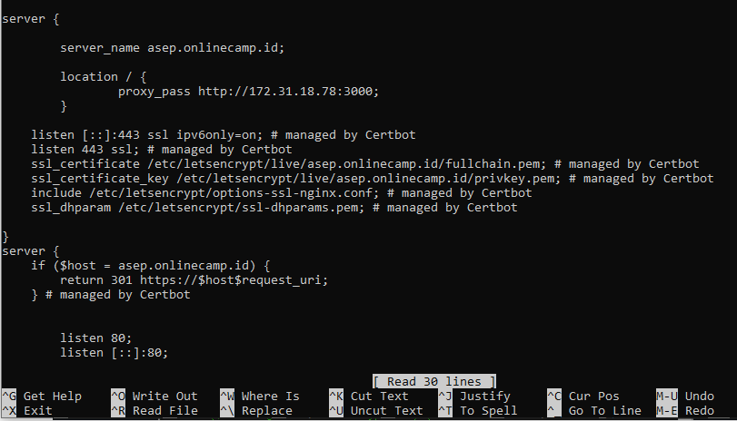
Konfigurasi SSL
sudo certbot --nginx -d asep.onlinecamp.id
Cek konfigurasi apakah sudah sudah menerapkan SSL di nginx

Slide 27
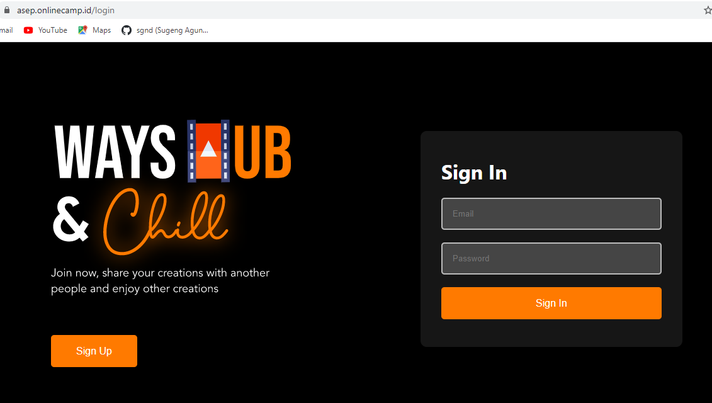
Konfigurasi SSL

Slide 28
Terima Kasih

